Slide 1
Business interview
Name:
Institution Affiliate:
Course:
Date:

Slide 2
Introduction
Mattingly Concrete which is a company located in Indianapolis and specializes in the restoring of concrete.
The company was founded in 1987 and has 26 employees.
The interview will also evaluate the business layout as demonstrated by Mattingly Concrete.
The manager was interviewed concerning the structure and running of the business.

Slide 3
Background
The company deals with the all types of concrete construction and restoration.
The company is advancing concrete industry by offering commercial services to various customers like school corporations.
The company is a franchise firm because it has been granted permission to offer commercial services to the public.
The company has completed over 2200 projects in the Indiana market alone (McCaffer, 2000).

Slide 4
Challenges encountered by the firm.
The company faces multiple challenges including the time constraints.
Regulations by the government is another challenge facing the company.
Integration of technology is another challenge facing the company and adapting the contemporary technology.
Slow implementation of the modern technology and competition from other firms.
Changes in weather sometimes are very harsh which distracts the schedule of project completion.

Slide 5
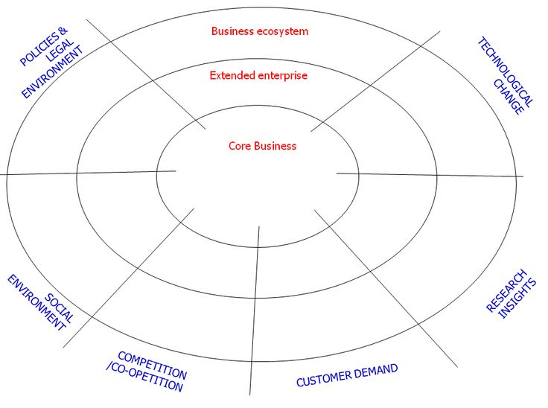
Business process strategy

Slide 6
Business layout
The layout of the firm has utilized the space critically and ensuring the traffic lanes for the heavy trucks.
The facilities of the company are laid out in a manner that eases the communication and support with the customers.
The layout of the company and the facilities are designed for future expansion and ensures smooth flow of the movement.
The facilities used in the construction ensure the safety of the employees.

Slide 7
Conclusion
The interview has studied an interview conducted with the president of the Mattingly Concrete Inc. which is located in Indianapolis.
The interview has also analyzed various challenges that the company is facing.
The business layout has also been explained according to the interview with William Mattingly.
Therefore, the company deals with concrete constructions and replacement and is one of the leading companies in America.

Slide 8
References
Edum-Fotwe, F., & McCaffer, R. (2000). Developing project management competency: perspectives from the construction industry. International Journal of Project Management, 18(2), 111-124. doi:10.1016/s0263-7863(98)90075-8
De Graaf, S. (2016). The Construction and Use of Hope within Health-Settings: Recent Developments in Qualitative Research and Ethnographic Studies. Sociology Compass, 10(7), 603-612. doi:10.1111/soc4.12380
Pheng, L. S., & Teo, J. A. (2004). Implementing Total Quality Management in Construction Firms. Journal of Management in Engineering, 20(1), 8-15. doi:10.1061/(asce)0742-597x (2004)20:1(8)

